Slide 1



Group 054
* Li-An Wu
* Ray Huang
* Tony Lin
* Steven Kan

Slide 2

Background
In December 2019, COVID-19 was first discovered in Wuhan, China.

Slide 3
Research Question
Does the GDP or poverty rate of a country affect its death/infected/recovered rate of the COVID-19?
- Is there any negative correlation between the economic status and mortality rate of COVID-19?
- Is there any negative correlation between the economic status and infection rate of COVID-19?
- Is there any positive correlation between the economic status and recovered rate of COVID-19?

Slide 4
Hypothesis
Rich Countries = lower death/infected rate?
= higher recovery rate?
Poor Countries = higher death/infected rate?
= lower recovery rate

Slide 5


Dataset
GDP from IMF(International Monetary Fund)
COVID-19 Data from worldometer

Slide 6
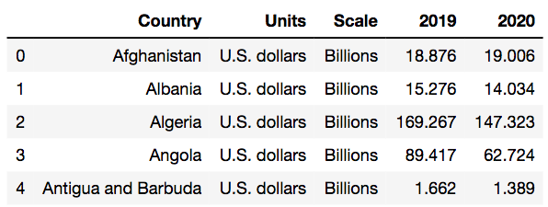
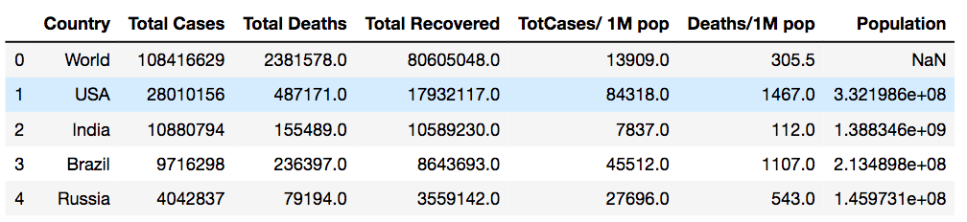
Data Cleaning
Data from IMF
Data from worldometer

Slide 7
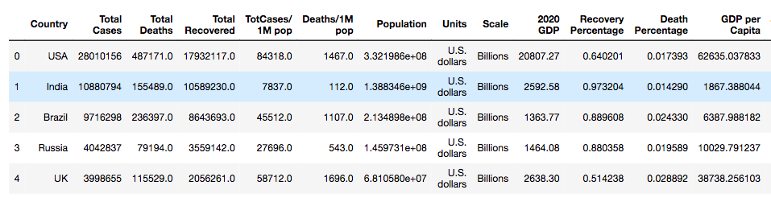
Data Wrangling(Cleaning)
Merge the corresponding countries name
Add extra columns for EDA

Slide 8
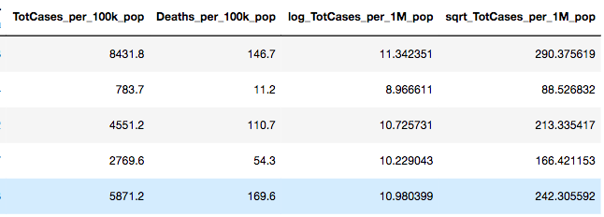
Data Wrangling(Cleaning) cont.

Slide 9
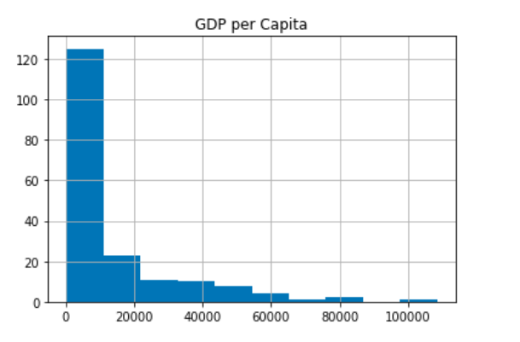
Data Analysis & Results(EDA) - 1
GDP Histogram (Right Skew)

Slide 10
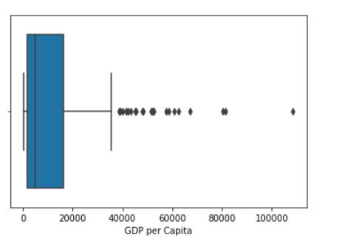
Data Analysis & Results(EDA) - 2
GDP Boxplot & statistics
GDP:
Mean: 13,416
Median: 4,791
Max: 108,527
75th percentile: 16,301
Since majority of GDP per capita lies highly clustering within 0 to 16,301, so we decide to split the countries into developed and developing based on it.

Slide 11
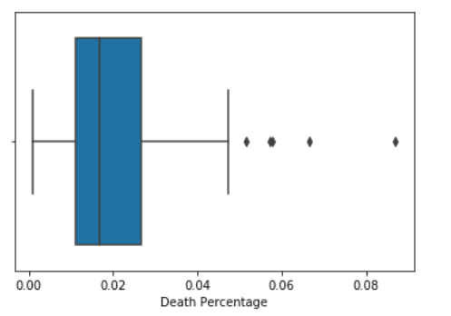
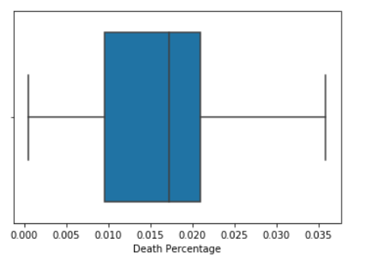
Data Analysis & Results(EDA) - 3
Remove the outlier(Yemen - highest death rate countries)
Death Rate from developing countries
Mean: 2.08%
Median: 1.70%
Max: 8.70%
Death Rate from developed countries
Mean: 1.65%
Median: 1.73%
Max: 3.59%

Slide 12
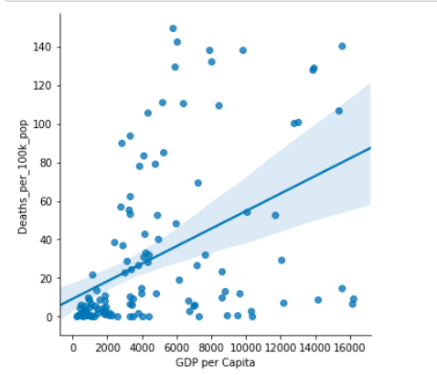
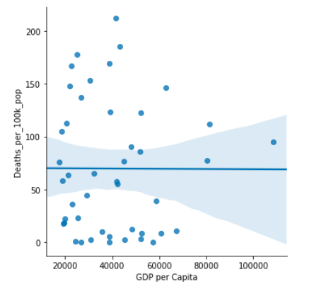
Data Analysis & Results(EDA) – 3 - 2
Death per 100k developing:
R^2 = 0.205
Death per 100k developed:
R^2 = 0.00
GDP has no correlation with Death Rate

Slide 13
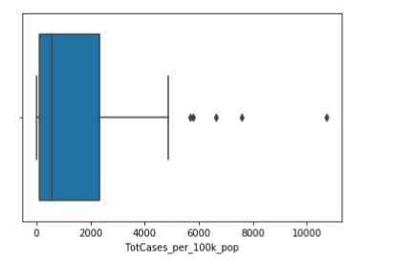
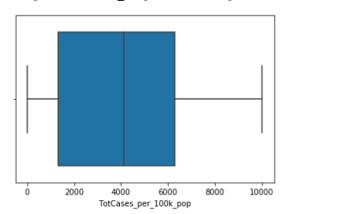
Data Analysis & Results(EDA) - 4
Infection Rate = Total Cases per 100k Population
Infection Rate from developing countries
Mean: 1,459
Median: 571
Max:10,737
Infection Rate from developed countries
Mean: 4,088
Median: 4,110
Max:10,017

Slide 14
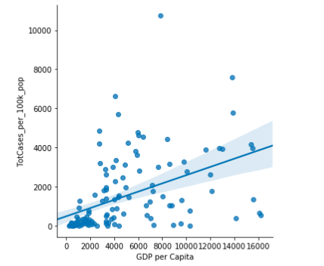
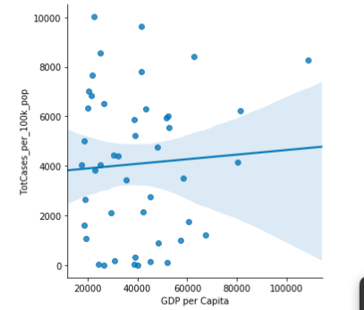
Data Analysis & Results(EDA) – 4 - 2
Infection rate developing:
R^2 = 0.221
Infection rate developed:
R^2 = 0.004
GDP has no correlation with Infection Rate

Slide 15
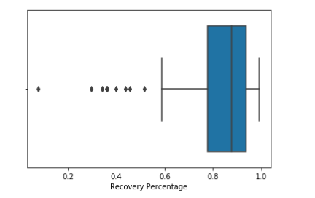
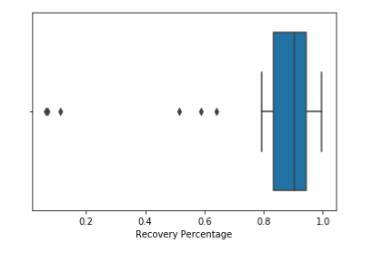
Data Analysis & Results(EDA) - 5
Recovery Rate from developing countries
Mean: 83.47%
Median: 88.04%
Max: 100%
Recovery Rate from developed countries
Mean: 81.00%
Median: 90.49%
Max: 99.63%

Slide 16
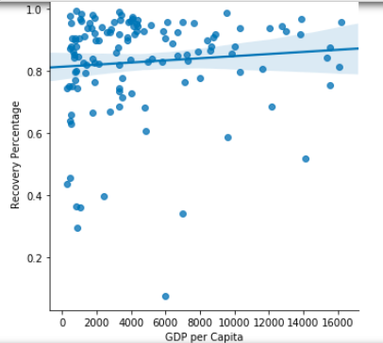
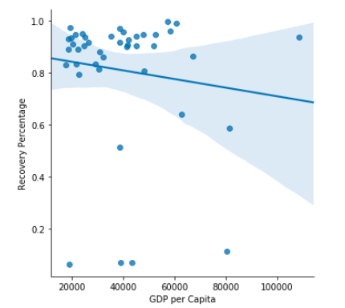
Data Analysis & Results(EDA) – 5 - 2
Recovery rate developing:
R^2 = 0.008
Recovery rate developed:
R^2 = 0.016
GDP has no correlation with Recovery Rate

Slide 17
Conclusion & Discussion
Our initial hypothesis that GDP of a country will have correlations between death/infected/recovered rate from COVID-19 is not supported by the use of linear regressions and measuring of central tendency.
But we discovered that developed countries has higher infection rate( 4,110 cases per 100k population) than developing countries(1,459cases per 100k population)
1. Biased Data from IMF or worldometer.
2. Do people in developing countries have stronger public awareness toward the danger of COVID-19 than those in developed country?

